Slide 1
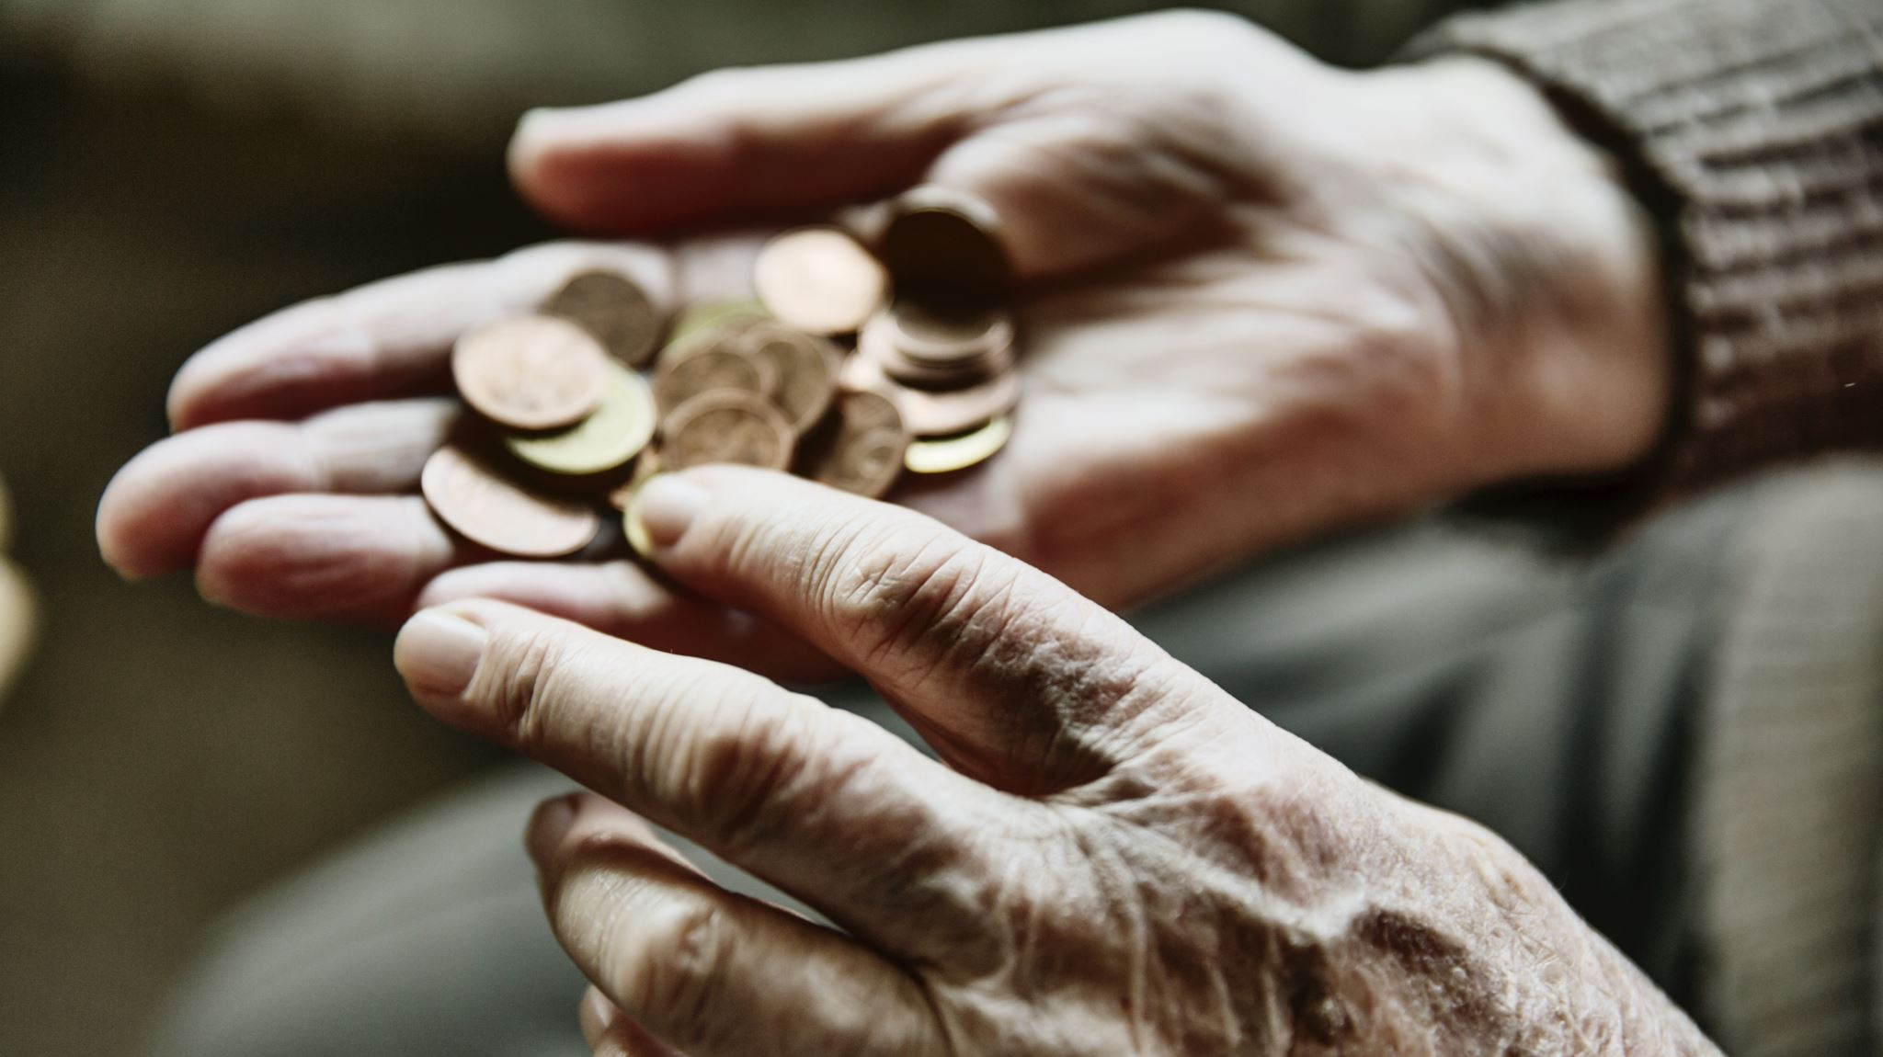
SOCIAL ISSUES OF INDIA
POVERTY

Slide 2
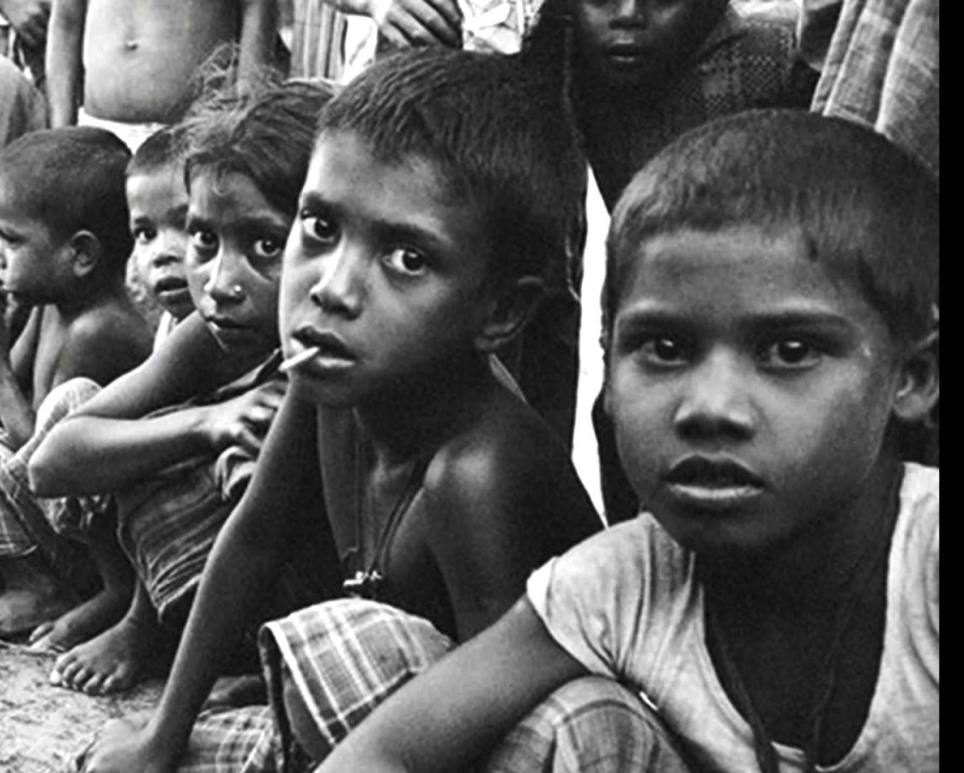
POVERTY
Poverty is a condition of an individual in which his income is so low that he is unable to feed or provide shelter for himself and his family members. Those who do have such income are called poor.

Slide 3
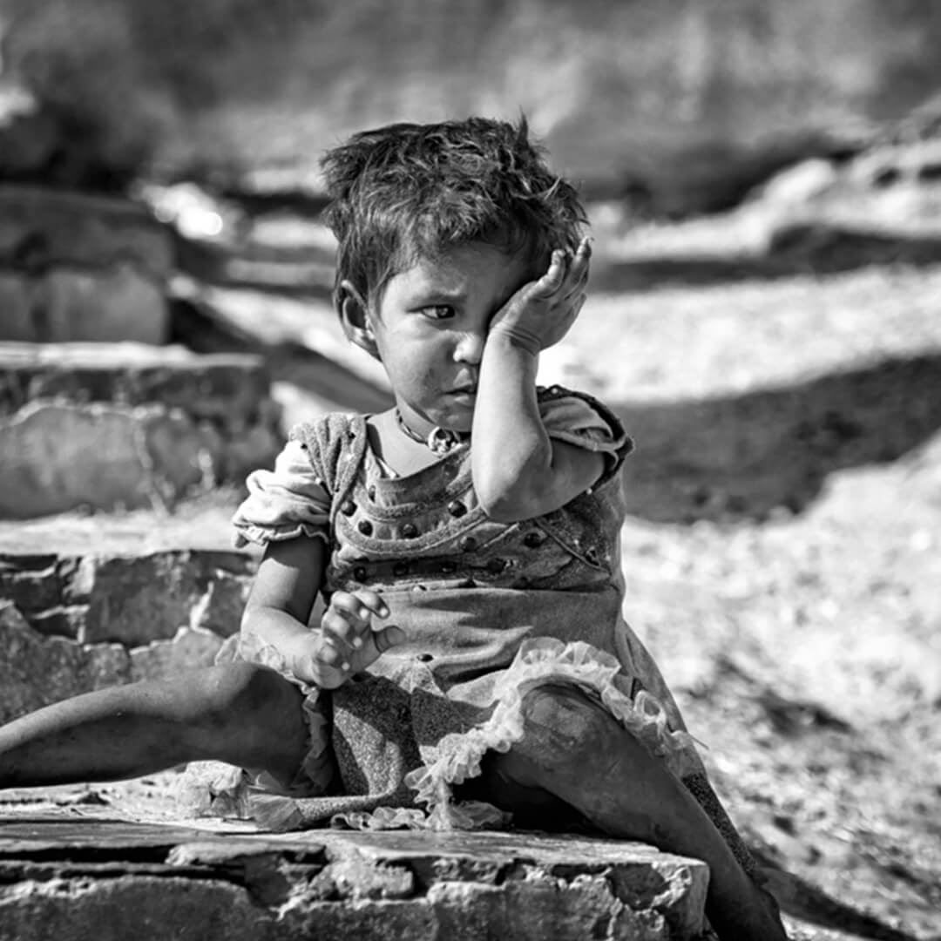
Causes of poverty
Social Causes
Religious Causes
Economic Causes
Natural Causes
Regional disparity
Caste System
Illiteracy
Political Causes
Slow Job Growth
Physical Causes

Slide 4
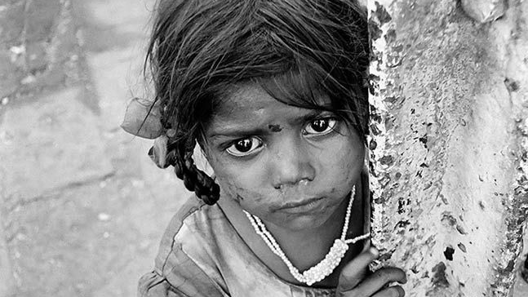
CONSEQUENCES OF POVERTY
Malnutrition
Illiteracy
Diseases and Longterm Health Problems
Unhygienic Living Conditions
Lack of Proper Housing
High Infant Mortality
Child Labor
Injustice to Women

Slide 5
Measures of poverty
Small Farmers Development Programme
Drought Area Development Programme
National Rural Employment Programme
Minimum Needs Programme
Assurance on Employment

Slide 6
Thank you
Presented by
P.N.U.ALEKHYA

